Slide 1

FE-545

Slide 2
Binomial Option Pricing
FE-545
Lecture 8
Ricardo A. Collado Assistant Professor School of Business

Slide 3
1. Coding Exotic Options

Slide 4

Options Assumptions
Assumptions:
Derivative is discrete, i.e. that it depends upon the value of spot on a discrete set of times
The derivative is associated to a set of times, $t_{1}, t_{2}, …, t_{n},$ and pays at some time T a function $f(S_{t1}, …, S_{tn})$ of the value of spot at those times.
Example: one-year Asian call option struck at K with monthly resets would pay $(\frac{1}{12}{\sum_{\left\{i=1\right\}}^{12}{S_{tj}−K)}}_{+}$, where $t_{j}=\frac{j}{12},$ at time 1.
More generally, the derivative could possibly pay cash-flows at more than one time.

Slide 5
Components & Actions:

Slide 6
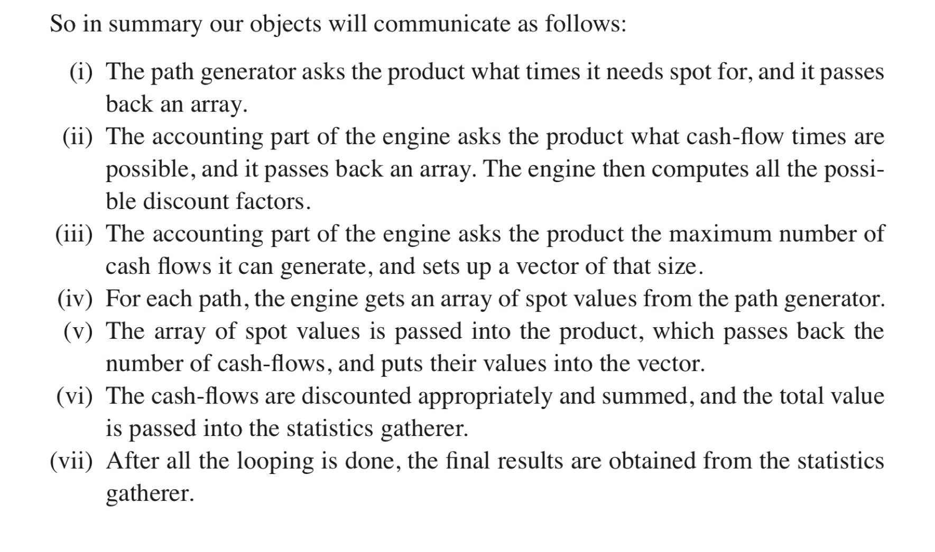
Communication:

Slide 7
Black-Scholes Path Generation Engine

Slide 8
Code:

Slide 9
2. Concepts of Binomial Option Pricing

Slide 10
Introduction to Binomial Option Pricing
Binomial option pricing enables us to determine the price of an option, given the characteristics of the stock or other underlying asset.
The binomial option pricing model assumes that the price of the underlying asset follows a binomial distribution—that is, the asset price in each period can move only up or down by a specified amount.
The binomial model is often referred to as the “Cox-Ross-Rubinstein pricing model.”

Slide 11
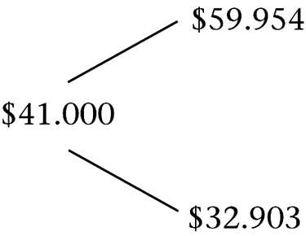
A One-Period Binomial Tree
Example:
Consider a European call option on the stock of XYZ, with a $40 strike and 1 year to expiration.
XYZ does not pay dividends, and its current price is $41.
The continuously compounded risk-free interest rate is 8%.
The following figure depicts possible stock prices over 1 year, i.e., a binomial tree.

Slide 12
Computing the option price
Next, consider two portfolios:
Portfolio A: Buy one call option.
Portfolio B: Buy 0.7376 shares of XYZ and borrow $22.405 at the risk-free rate.
Costs:
Portfolio A: The call premium, which is unknown.
Portfolio B: 0.7376 × $41 – $22.405 = $7.839.

Slide 13
Computing the option price
Payoffs:
Portfolio A: Stock Price in 1 Year
$32.903 $59.954
Payoff 0 $19.954
Portfolio B: Stock Price in 1 Year
$32.903 $59.954
0.7376 purchased shares $24.271 $44.225
Repay loan of $22.405 – $24.271 – $24.271
Total payoff 0 $19.954

Slide 14
Computing the option price
Portfolios A and B have the same payoff. Therefore,
Portfolios A and B should have the same cost. Since Portfolio B costs $7.839, the price of one option must be $7.839.
There is a way to create the payoff to a call by buying shares and borrowing. Portfolio B is a synthetic call.
One option has the risk of 0.7376 shares. The value 0.7376 is the delta (Δ) of the option: The number of shares that replicates the option payoff.

Slide 15
Intuition and Second Approach
When the stock price goes up by one unit, the call option price goes up by Δ units.
Hence buy Δ shares of the stock and short (write) one call option in order to obtain a risk-free portfolio.

Slide 16
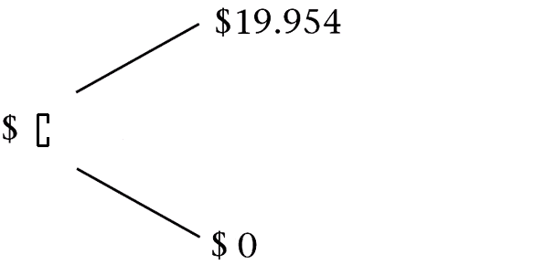
Intuition and Second Approach
Recall that:
Hence:

Slide 17
Intuition and Second Approach
We can then compute Δ as
(19.954-0) / (59.954-32.903) = .7376
Buying Δ shares and writing one option costs (.7376)(41) - C

Slide 18
Intuition and Second Approach
The payout in the upper scenario is:
(.7376)(59.954) – 19.954
The payout in the lower scenario is:
(.7376)(32.903) - 0
The payout is thus equal in both cases to:
$ 24.27 (verify this)

Slide 19
Intuition and Second Approach
Since the payout is the same in both cases, the investment is indeed risk-free.
This means that the cost of this strategy is equal to the payoff discounted by the risk-free rate (continuous compounding used here)

Slide 20
Intuition and Second Approach
Hence we have:
(.7376)(41) – C = 24.27 exp(-0.08)
The Call option price can thus be inferred from this equation and is equal to:
C = $ 7.838 (same result as before)

Slide 21
Intuition and Second Approach
Note that in order to obtain the price of the call option we did not need to know how much to borrow at the risk-free rate.
The borrowing mentioned in the first few slides was a way to replicate the payoff of the call option, when combined with the purchasing of Δ shares (in order to subsequently be able to make the argument: same future payoff, same price today)

Slide 22
How to Compute the Amount of Riskless Borrowing (if needed):
Without borrowing, having bought Δ shares yields (.7376)(59.954) or 44.222 in the upper scenario and (.7376)(32.903) or 24.269 in the lower scenario.
In order to replicate the payoffs of the Call option (19.954 in the upper scenario and 0 in the lower scenario), we need to subtract 24.269 from the stock payouts.

Slide 23
How to Compute the Amount of Riskless Borrowing (if needed):
Subtracting 24.269 in the next period is the result of having borrowed the present value of that amount in the first period.
Hence the amount of riskless borrowing is 24.269 exp(-0.08), or $ 22.403 (recall we had $ 22.405 in the first few slides, due to different rounding)

Slide 24
Additional Example:
The current stock price is $40, and in one year the stock can either go up to $50 or go down to $30.
There exists a call option on the stock with an exercise price K=$40.
What is the price of the call, and what is the amount you would need to borrow if you wanted to replicate the option payoff? (while having purchased Δ shares of the stock)

Slide 25
Answers:
Call Option price: $ 6.153
Amount Borrowed:
15 exp(-0.08) = $ 13.847

Slide 26
Third Approach
Pretend that investors are risk neutral, i.e. assets only need to return the risk-free rate.
Compute the “risk-neutral probabilities” associated with the stock in this risk-neutral world.
Use these probabilities to compute the expected option payoff, and discount back to the present at the risk-free rate in order to get today’s option price.

Slide 27
Third Approach
Let p* be the risk-neutral probability of the stock going up.
Then we have:
p*(59.954)+(1-p*)(32.903) = 41 exp(0.08)
Hence p* = 0.425558

Slide 28
Third Approach
The Call price can then be computed as the “risk-neutral” discounted expected value of payoffs 19.954 and 0:
C = [p*(19.954)+(1-p*)(0) ] exp(-0.08)
with p* = 0.425558
Hence we have:
C = $ 7.838 (confirming our previous results)

Slide 29
The binomial solution
How do we find a replicating portfolio consisting of Δ shares of stock and a dollar amount B in lending, such that the portfolio imitates the option whether the stock rises or falls?
Suppose that the stock has a continuous dividend yield of δ, which is reinvested in the stock. Thus, if you buy one share at time t, at time t+h you will have e^{δh} shares.
If the length of a period is h, the interest factor per period is e^{rh}.
uS₀ denotes the stock price when the price goes up, and dS₀ denotes the stock price when the price goes down.

Slide 30
The binomial solution
• Stock price tree: • Corresponding tree for
the value of the option:
uS₀ C_{u}
S₀ C₀
dS₀ C_{d}
Note that u (d) in the stock price tree is interpreted as one plus the rate of capital gain (loss) on the stock if it goes up (down).
The value of the replicating portfolio at time h, with stock price S_{h}, is
Δ S_{h} + e^{rh} B

Slide 31
The binomial solution
At the prices S_{h} = uS and S_{h} = dS, a replicating portfolio will satisfy
(Δ × uS × e^{δh} ) + (B × e^{rh}) = C_{u}
(Δ × dS × e^{δh} ) + (B × e^{rh}) = C_{d}
Solving for Δ and B gives
(10.1)
(10.2)

Slide 32
The binomial solution
The cost of creating the option is the cash flow required to buy the shares and bonds. Thus, the cost of the option is ΔS+B.
(10.3)
The no-arbitrage condition is
u > e^{(r–δ)h} > d (10.4)
Where does the condition come from?

Slide 33
The Arbitrage Condition Explained
Assume for a moment that we have e^{(r–δ)h} > u
(i.e. Se^{(r–δ)h} > Su )
An arbitrage strategy would be to short-sell the stock, invest the proceeds at the riskless rate, buy the stock back, and pocket the difference.
Short-sell the stock: collect S immediately.
Invest the proceeds for a length of time h while paying the dividends δ to the original owner of the stock, should they occur: get Se^{(r–δ)h} in the next period.
If stock ends up at Su, buy back the stock, return it to its original owner, and pocket Se^{(r–δ)h} –Su >0.
Note that if the stock goes down to Sd instead, the profit is even larger: Se^{(r–δ)h} –Sd >>0

Slide 34
The Arbitrage Condition Explained
Assume now that we have e^{(r–δ)h} < d (i.e. Se^{rh} < Sde^{δh} )
An arbitrage strategy would be to borrow $ S at the riskless rate, use the funds to buy the stock today holding it for a period of time h, reselling the stock in the next period, repaying your loan and pocketing the difference.
Borrow $ S at the riskless r and use the funds to buy S.
Hold S for a period h, and if stock goes down (worst case scenario), collect Sde^{δh} (sale of stock plus δ received).
Repay loan + interest, i.e. Se^{rh} , pocket Sde^{δh} –Se^{rh} >0.
Note that if the stock goes up to Su instead, the profit is even larger: Sue^{δh} –Se^{rh} >>0.

Slide 35
Binomial Example
Let S=$100, K=$95, r=0.08%, no dividends
One-step binomial setup, u=1.3, d=0.8
What is the price of a European Call option on the security S?
What is its delta?
What is the amount B?

Slide 36
Arbitraging a mispriced option
If the observed option price differs from its theoretical price, arbitrage is possible.
If an option is overpriced, we can sell the option. However, the risk is that the option will be in the money at expiration, and we will be required to deliver the stock. To hedge this risk, we can buy a synthetic option at the same time we sell the actual option.
If an option is underpriced, we buy the option. To hedge the risk associated with the possibility of the stock price falling at expiration, we sell a synthetic option at the same time.

Slide 37
Example
Let S=$100, K=$95, r=0.08%, no dividends
One-step binomial setup, u=1.3, d=0.8
Suppose you observe a Call price of $17. What is the arbitrage?
Suppose you observe a Call price of $15.50. What is the arbitrage?

Slide 38
A graphical interpretation of the binomial formula
The portfolio describes a line with the formula
C_{h} = ΔS_{h} + e^{rh} B ,
where C_{h} and S_{h} are the option and stock value after one binomial period, and supposing δ = 0.
We can control the slope of a payoff diagram by varying the number of shares, Δ, and its height by varying the number of bonds, B.
Any line replicating a call will have a positive slope (Δ > 0) and negative intercept (B < 0). (For a put, Δ < 0 and B > 0.)

Slide 39
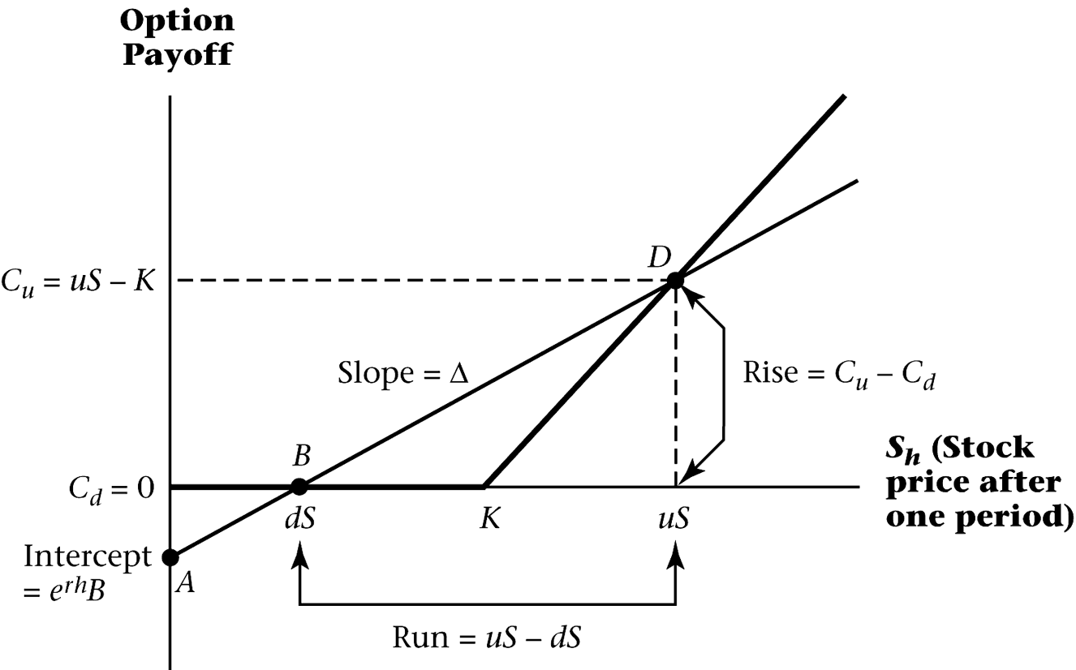
A graphical interpretation of the binomial formula

Slide 40
Risk-neutral pricing
We can interpret the terms (e^{(r–δ)h} – d )/(u – d) and
(u – e^{(r–δ)h} )/(u – d) as probabilities.
In equation (10.3), they sum to 1 and are both positive.
Let
(10.5)
Then equation (10.3) can then be written as
C = e^{–rh} [p* C_{u} + (1 – p*) C_{d}] , (10.6)
where p* is the risk-neutral probability of an increase in the stock price.

Slide 41
Where does the tree come from?
In the absence of uncertainty (if we faced that situation), a stock must appreciate at the risk-free rate less the dividend yield. Thus, from time t to time t+h, we have
S_{t+h} = S_{t} e^{(r–δ)h} = F_{t,t+h}
The price next period equals the forward price.

Slide 42
Where does the tree come from?
With uncertainty, the stock price evolution is
(10.8)
,
where σ is the annualized standard deviation of the continuously compounded return, and σ√h is standard deviation over a period of length h.
We can also rewrite (10.8) as
(10.9)
We refer to a tree constructed using equation (10.9) as a “forward tree.”

Slide 43
Summary
In order to price an option, we need to know
stock price,
strike price,
standard deviation of returns on the stock,
dividend yield,
risk-free rate.
Using the risk-free rate and σ, we can approximate the future distribution of the stock by creating a binomial tree using equation (10.9).
Once we have the binomial tree, it is possible to price the option using equation (10.3).

Slide 44
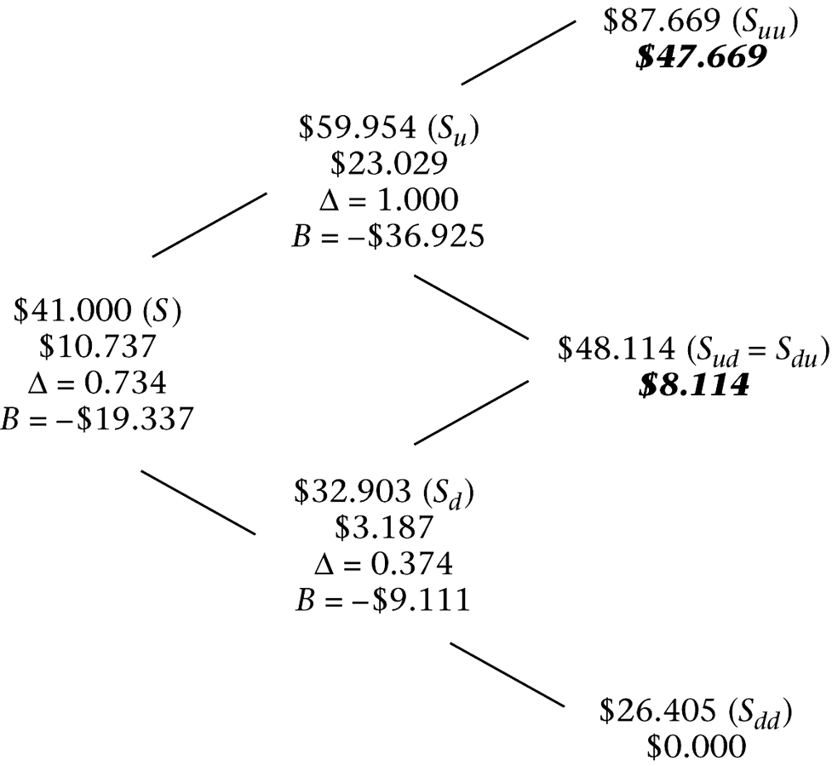
A Two-Period European Call
We can extend the previous example to price a 2-year option, assuming all inputs are the same as before.

Slide 45
A Two-Period European Call
Note that an up move by the stock followed by a down move (S_{ud}) generates the same stock price as a down move followed by an up move (S_{du}). This is called a recombining tree. (Otherwise, we would have a nonrecombining tree).
S_{ud} = S_{du} = u × d × $41 = e^{(0.08+0.3)} × e^{(0.08–0.3)} × $41 = $48.114

Slide 46
Pricing the call option
To price an option with two binomial periods, we work backward through the tree.
Year 2, Stock Price=$87.669: Since we are at expiration, the option value is max (0, S – K) = $47.669.
Year 2, Stock Price=$48.114: Similarly, the option value is $8.114.
Year 2, Stock Price=$26.405: Since the option is out of the money, the value is 0.

Slide 47
Pricing the call option
Year 1, Stock Price=$59.954: At this node, we compute the option value using equation (10.3), where
uS is $87.669 and dS is $48.114.
Year 1, Stock Price=$32.903: Again using equation (10.3), the option value is $3.187.
Year 0, Stock Price = $41: Similarly, the option value is computed to be $10.737.

Slide 48
Pricing the call option
Notice that:
The option was priced by working backward through the binomial tree.
The option price is greater for the 2-year than for the 1-year option.
The option’s Δ and B are different at different nodes. At a given point in time, Δ increases to 1 as we go further into the money.
Permitting early exercise would make no difference. At every node prior to expiration, the option price is greater than
S – K; thus, we would not exercise even if the option was American.

Slide 49
Many binomial periods
Dividing the time to expiration into more periods allows us to generate a more realistic tree with a larger number of different values at expiration.
Consider the previous example of the 1-year European call option.
Let there be three binomial periods. Since it is a 1-year call, this means that the length of a period is h = 1/3.
Assume that other inputs are the same as before (so, r = 0.08 and σ = 0.3).

Slide 50
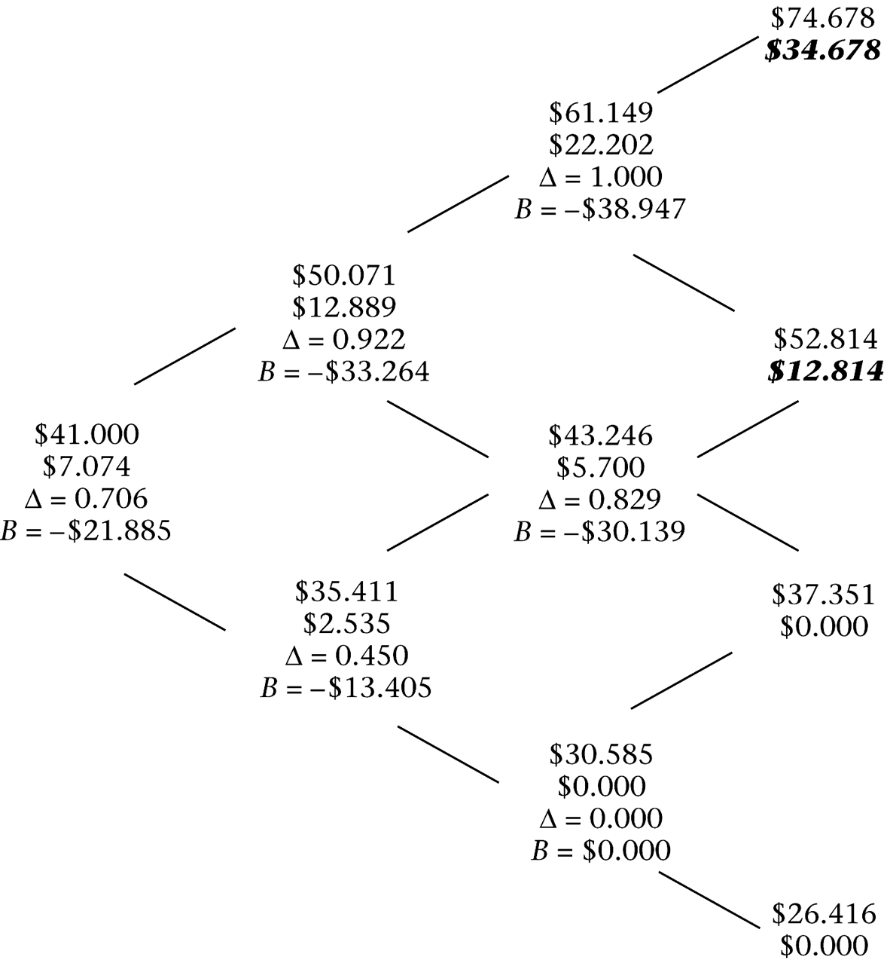
Many binomial periods
The stock price and option price tree for this option:

Slide 51
Many binomial periods
Note that since the length of the binomial period is shorter, u and d are smaller than before: u = 1.2212 and d = 0.8637 (as opposed to 1.462 and 0.803 with h = 1).
The second-period nodes are computed as follows:
The remaining nodes are computed similarly.
Analogous to the procedure for pricing the 2-year option, the price of the three-period option is computed by working backward using equation (10.3).
The option price is $7.074.

Slide 52
Put Options
We compute put option prices using the same stock price tree and in the same way as call option prices.
The only difference with a European put option occurs at expiration.
Instead of computing the price as max (0, S – K), we use max (0, K – S).

Slide 53
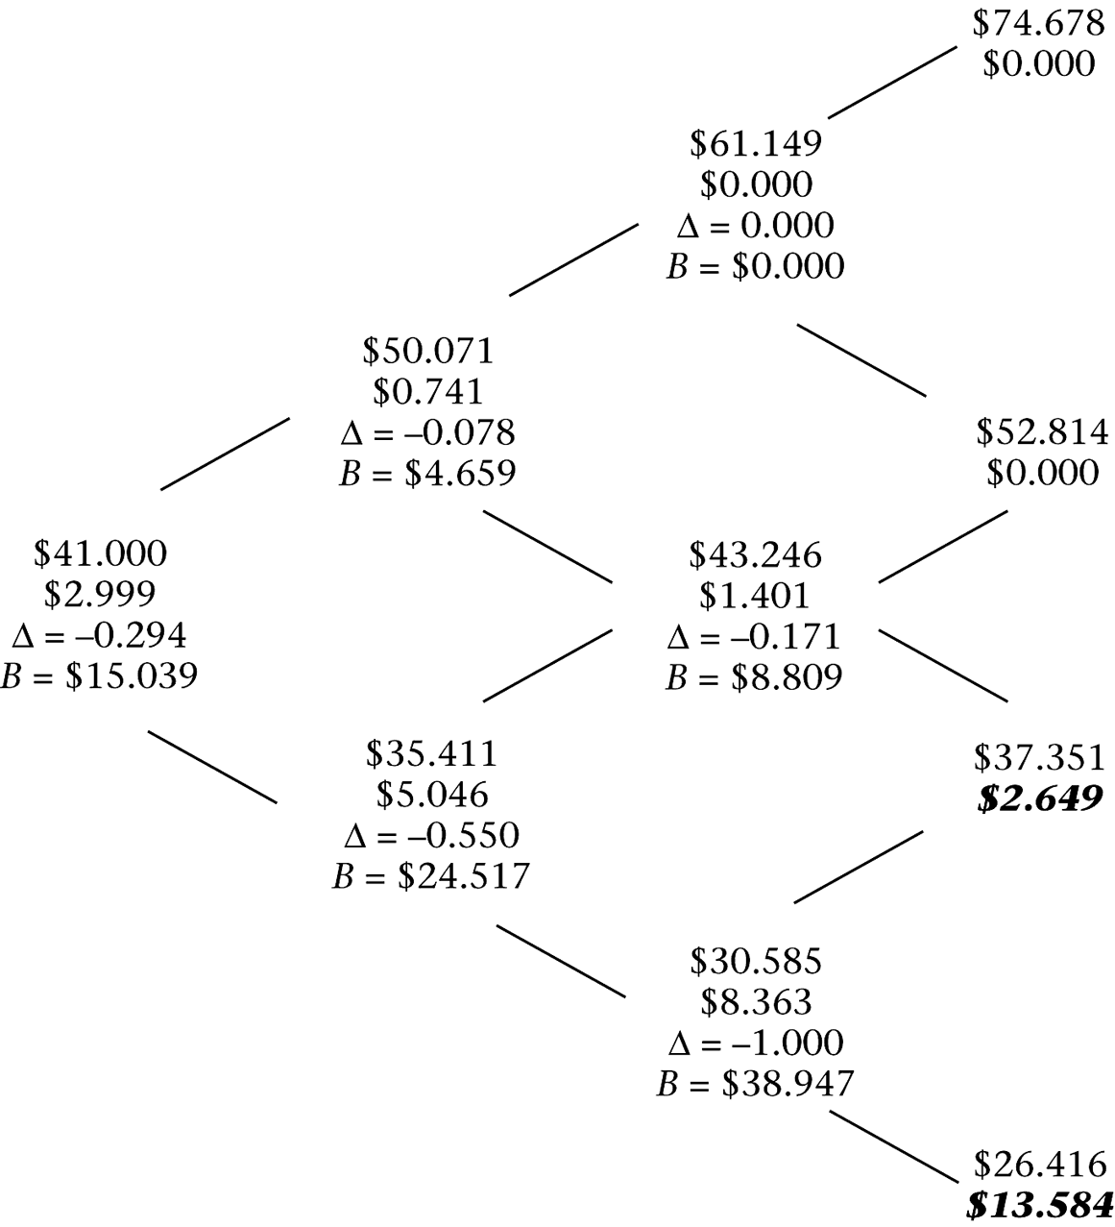
Put Options
A binomial tree for a European put option with 1-year to expiration:

Slide 54
American Options
The value of the option if it is left “alive” (i.e., unexercised) is given by the value of holding it for another period, equation (10.3).
The value of the option if it is exercised is given by
max (0, S – K) if it is a call and max (0, K – S) if it is a put.
For an American call, the value of the option at a node is given by
C(S, K, t) = max (S – K, e^{–rh} [C(uS, K, t + h) p* +
C(dS, K, t + h) (1 – p*)]) (10.10)

Slide 55
American Options
The valuation of American options proceeds as follows:
At each node, we check for early exercise.
If the value of the option is greater when exercised, we assign that value to the node. Otherwise, we assign the value of the option unexercised.
We work backward through the three as usual.

Slide 56
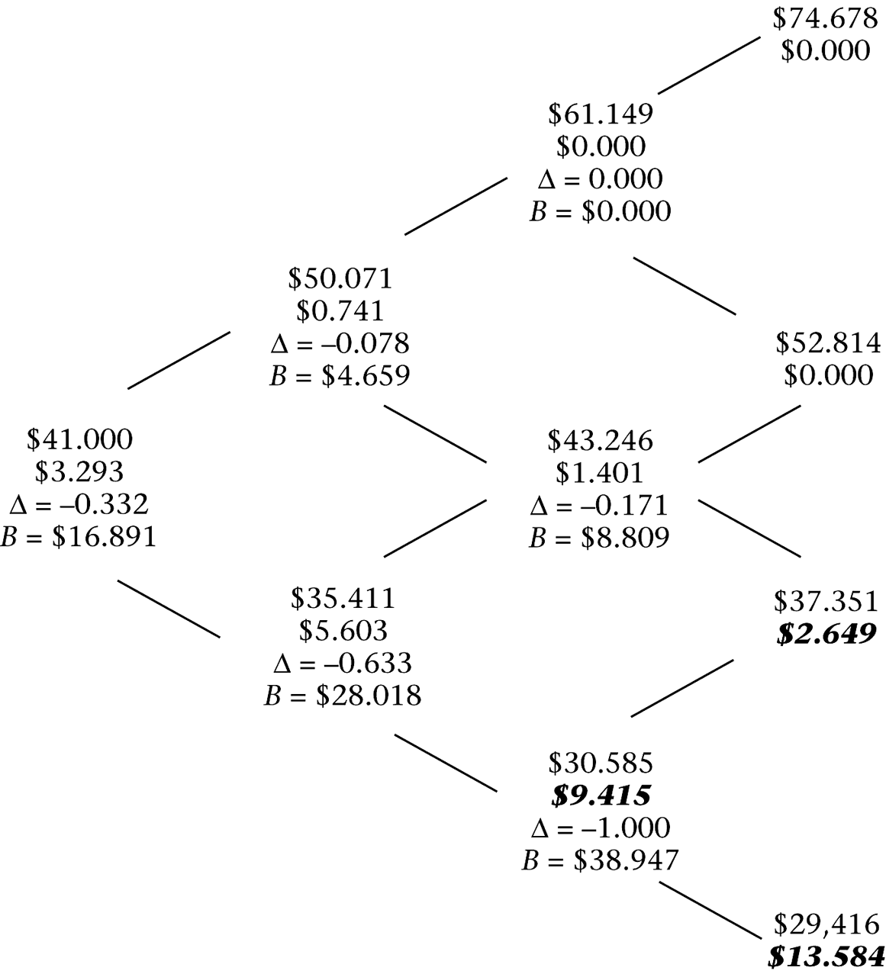
American Options
Consider an American version of the put option valued in the previous example:

Slide 57
American Options
The only difference in the binomial tree occurs at the S_{dd} node, where the stock price is $30.585. The American option at that point is worth $40 – $30.585 = $9.415, its early-exercise value (as opposed to $8.363 if unexercised). The greater value of the option at that node ripples back through the tree.
Thus, an American option is more valuable than the otherwise equivalent European option.

Slide 58
Options on Other Assets
The model developed thus far can be modified easily to price options on underlying assets other than nondividend-paying stocks.
The difference for different underlying assets is the construction of the binomial tree and the risk-neutral probability.
We examine options on
stock indexes, – commodities,
currencies, – bonds.
futures contracts,

Slide 59
Options on a stock index
Suppose a stock index pays continuous dividends at the rate Δ.
The procedure for pricing this option is equivalent to that of the first example, which was used for our derivation. Specifically,
the up and down index moves are given by equation (10.9),
the replicating portfolio by equation (10.1) and (10.2),
the option price by equation (10.3),
the risk-neutral probability by equation (10.5).

Slide 60
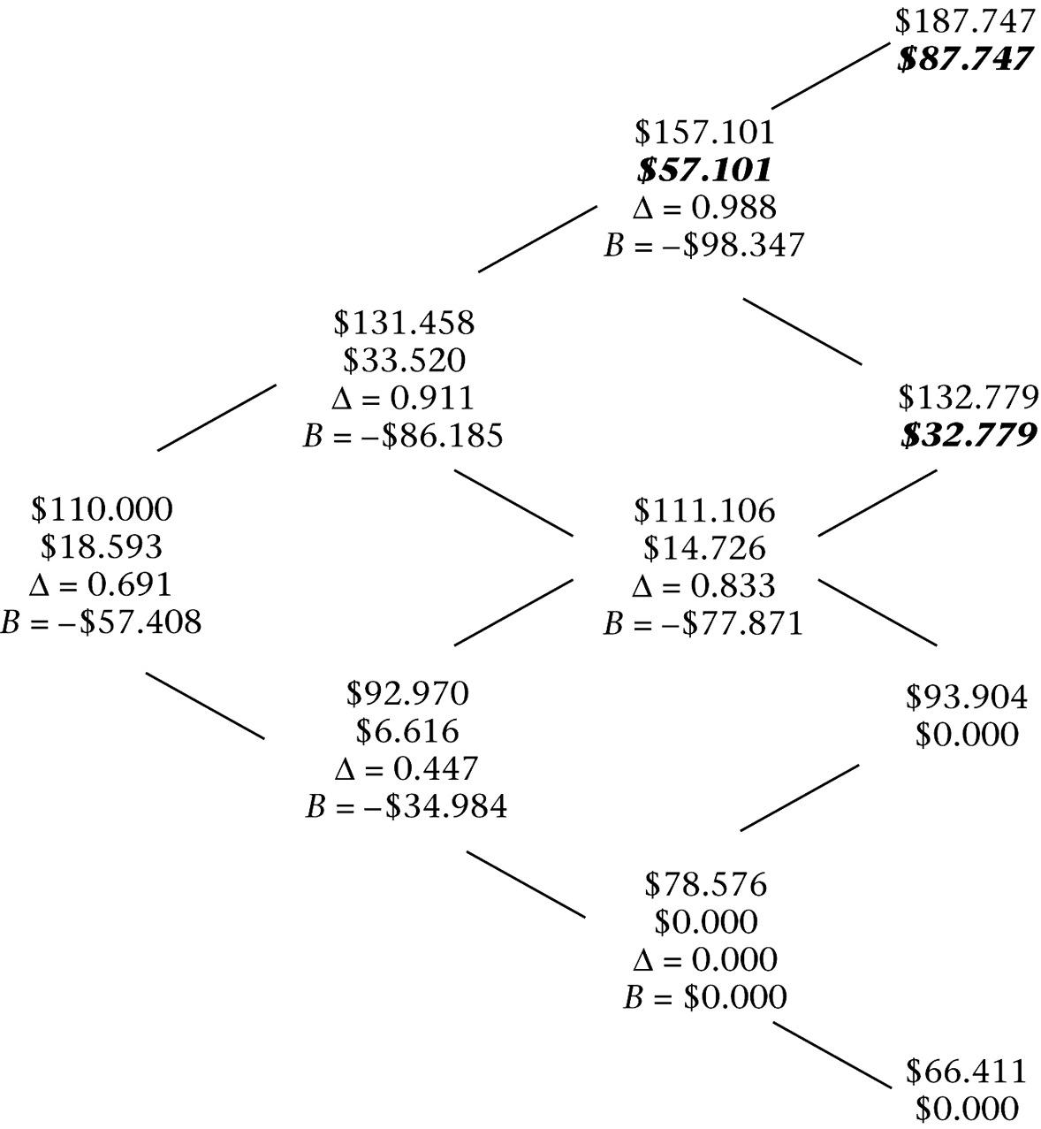
Options on a stock index
A binomial tree for an American call option on a stock index:

Slide 61
Options on currency
With a currency with spot price x₀, the forward price is
F_{0,t} = x₀e^{(r–rf)t} ,
where r_{f} is the foreign interest rate.
Thus, we construct the binomial tree using

Slide 62
Options on currency
Investing in a “currency” means investing in a money-market fund or fixed income obligation denominated in that currency.
Taking into account interest on the foreign-currency denominated obligation, the two equations are
Δ × uxe^{rfh} + e^{rh} × B = C_{u}
Δ × dxe^{rfh} + e^{rh} × B = C_{d}
The risk-neutral probability of an up move is
(10.11)

Slide 63
Options on currency
Consider a dollar-denominated American put option on the euro, where
the current exchange rate is $1.05/€,
the strike is $1.10/€,
the euro-denominated interest rate is 3.1%,
the dollar-denominated rate is 5.5%.

Slide 64
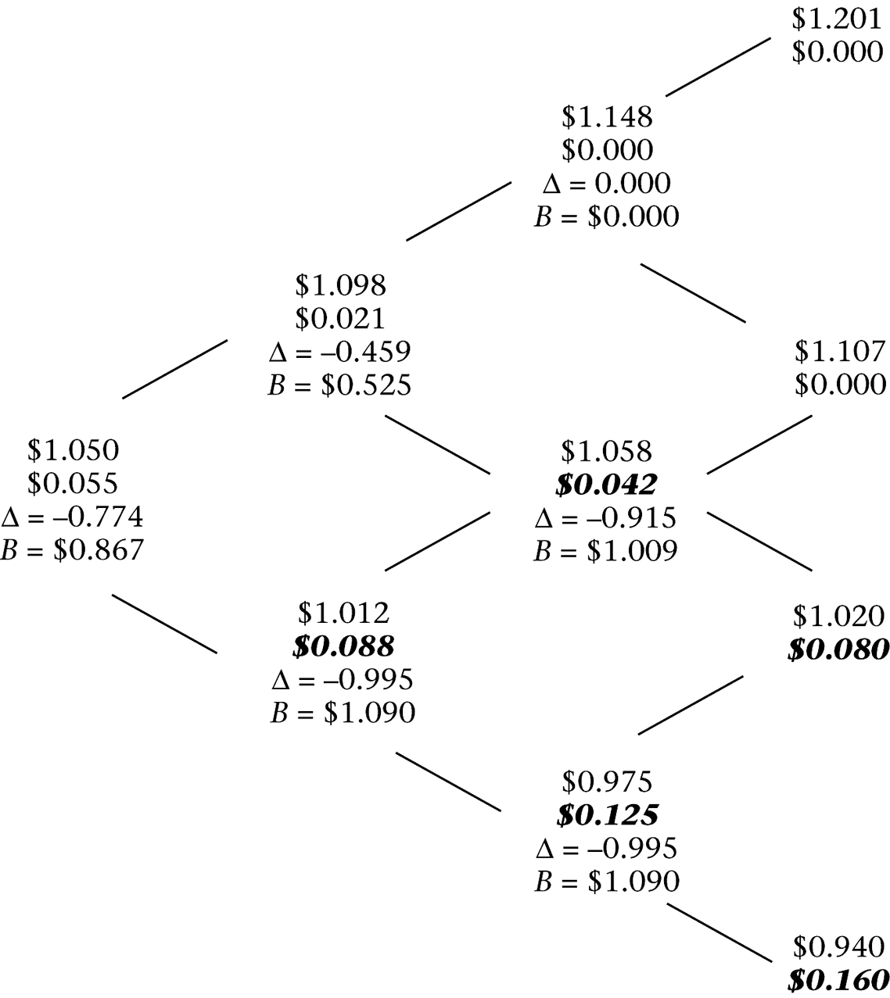
Options on currency
The binomial tree for the American put option on the euro:

Slide 65
Options on futures contracts
Assume the forward price is the same as the futures price.
The nodes are constructed as
We need to find the number of futures contracts, Δ, and the lending, B, that replicates the option.
A replicating portfolio must satisfy
Δ × (uF − F) + e^{rh} × B = C_{u}
Δ × (dF − F) + e^{rh} × B = C_{d}

Slide 66
Options on futures contracts
Solving for Δ and B gives
Δ tells us how many futures contracts to hold to hedge the option, and B is simply the value of the option.
We can again price the option using equation (10.3).
The risk-neutral probability of an up move is given by
(10.12)

Slide 67
Options on futures contracts
The motive for early-exercise of an option on a futures contract is the ability to earn interest on the mark-to-market proceeds.
When an option is exercised, the option holder pays nothing, is entered into a futures contract, and receives mark-to-market proceeds of the difference between the strike price and the futures price.

Slide 68
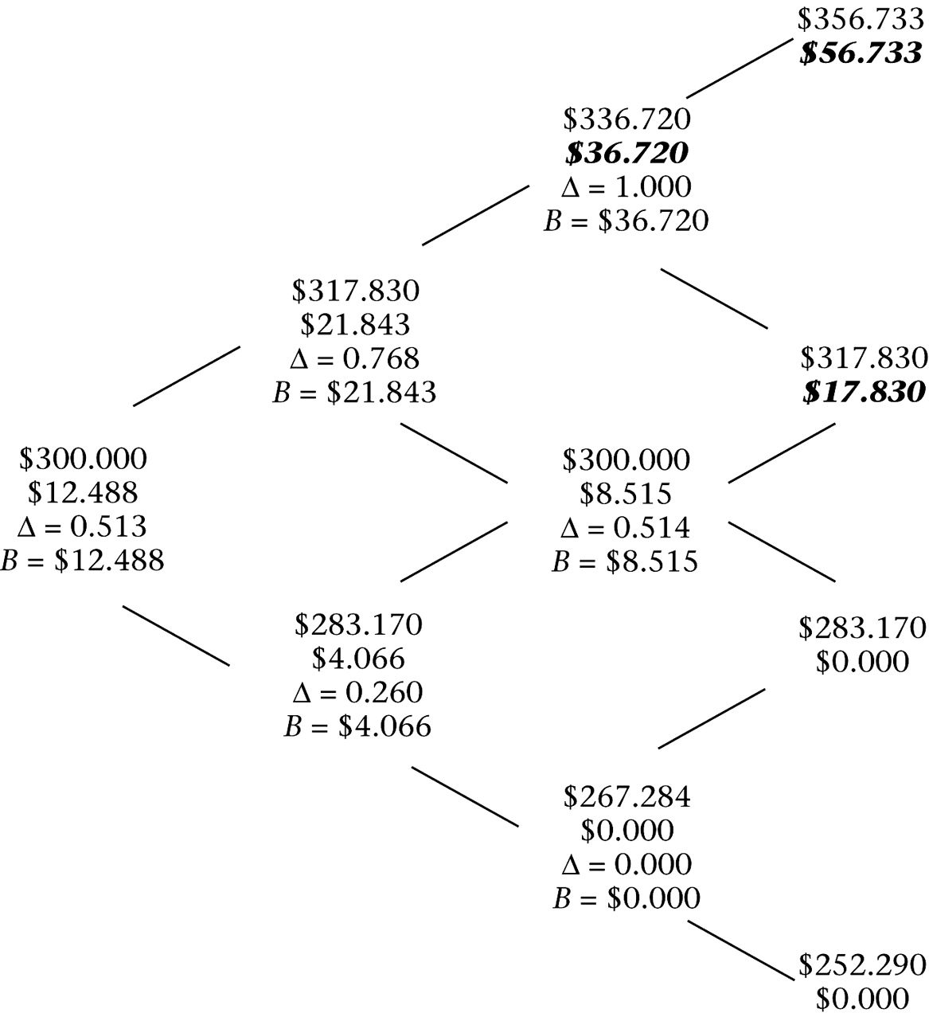
Options on futures contracts
A tree for an American call option on a gold futures contract:

Slide 69
Options on commodities
It is possible to have options on a physical commodity.
If there is a market for lending and borrowing the commodity, then pricing such an option is straightforward.
In practice, however, transactions in physical commodities often have greater transaction costs than for financial assets, and short-selling a commodity may not be possible.
From the perspective of someone synthetically creating the option, the commodity is like a stock index, with the lease rate equal to the dividend yield.

Slide 70
Options on bonds
Bonds are like stocks that pay a discrete dividend (a coupon).
Bonds differ from the other assets in two respects:
The volatility of a bond decreases over time as the bond approaches maturity.
The assumptions that interest rates are the same for all maturities and do not change over time are logically inconsistent for pricing options on bonds.

Slide 71
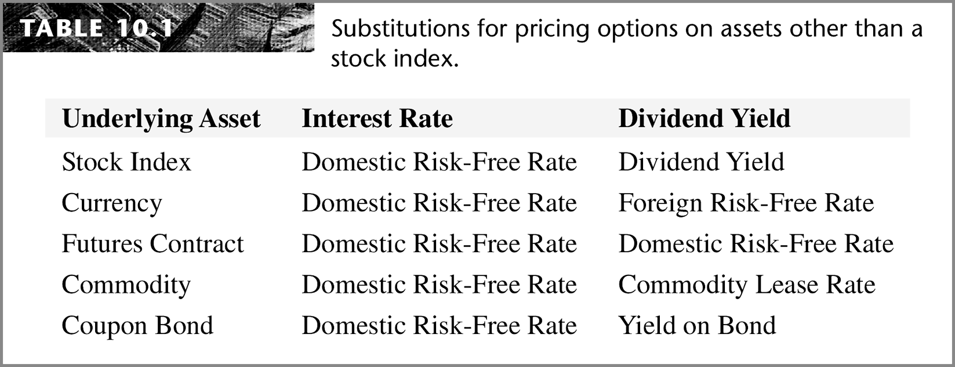
Summary
Pricing options with different underlying assets requires adjusting the risk-neutral probability for the borrowing cost or lease rate of the underlying asset.
Thus, we can use the formula for pricing an option on a stock index with an appropriate substitution for the dividend yield.

Slide 72
Ricardo A. Collado
rcollado@stevens.edu
(201) 216-8156

